Slide 1
ECEG-5193: Algorithm Analysis and Design
Analysis of Sorting and Searching Algorithms
Red Black Trees

Slide 2
Search might take time O(n).
2
This is a valid binary search tree.
The version with n nodes has depth n, not O(log(n)).
3
4
5
6
7
8

Slide 3
What to do?
How often is “every so often” in the worst case? It’s actually pretty often!
Goal: Fast SEARCH/INSERT/DELETE
All these things take time O(height)
And the height might be big!!! ☹
Idea 0:
Keep track of how deep the tree is getting.
If it gets too tall, re-do everything from scratch.
At least Ω(n) every so often….
Turns out that’s not a great idea. Instead we turn to…

Slide 4
Self-Balancing Binary Search Trees

Slide 5
Idea 1: Rotations
No matter what lives underneath A,B,C, this takes time O(1). (Why?)
Maintain Binary Search Tree (BST) property, while moving stuff around.
Note: A, B, C, X, Y are variable names, not the contents of the nodes.
X
Y
Y
Y
C
A
B
X
A
X
A
B
C
B fell down.
B
C
That’s not binary!!
CLAIM:
this still has BST property.

Slide 6
This seems helpful
3
5
2
5
3
7
4
7
2
4
6
8
6
8

Slide 7
Strategy?
Whenever something seems unbalanced, do rotations until it’s okay again.
Even for Lucky this is pretty vague. What do we mean by “seems unbalanced”? What’s “okay”?

Slide 8
Idea 2: have some proxy for balance
Maintaining perfect balance is too hard.
Instead, come up with some proxy for balance:
If the tree satisfies [SOME PROPERTY], then it’s pretty balanced.
We can maintain [SOME PROPERTY] using rotations.
There are actually several ways to do this, but today we’ll see…

Slide 9
Red-Black Trees
A Binary Search Tree that balances itself!
No more time-consuming by-hand balancing!
Red-Black tree!
5
3
7
Maintain balance by stipulating that black nodes are balanced, and that there aren’t too many red nodes.
2
4
6
8

Slide 10

Red-Black tree!
Dr. Rudolf Bayer
Professor Emeritus Technical University of Munich
Inventor of B-Trees (Data structure used in most database systems) and
UB-Trees (multi-dimensional data structure)

Slide 11
Red-Black Trees obey the following rules (which are a proxy for balance)
Every node is colored red or black.
The root node is a black node.
NIL children count as black nodes.
Children of a red node are black nodes.
For all nodes x:
all paths from x to NIL’s have the same number of black nodes on them.
5
3
7
2
4
6
8
I’m not going to draw the NIL children in the future, but they are treated as black nodes.
NIL
NIL
NIL
NIL
NIL
NIL
NIL
NIL

Slide 12
Examples(?)
Every node is colored red or black.
The root node is a black node.
NIL children count as black nodes.
Children of a red node are black nodes.
For all nodes x:
all paths from x to NIL’s have the same number of black nodes on them.
Which of these
are red-black trees?
(NIL nodes not drawn)
Yes!
No!
No!
No!

Slide 13
Why these rules???????
5
This is pretty balanced.
The black nodes are balanced
The red nodes are “spread out” so they don’t mess things up too much.
We can maintain this property as we insert/delete nodes, by using rotations.
3
7
2
4
6
8
9
This is the really clever idea!
This Red-Black structure is a proxy for balance.
It’s just a smidge weaker than perfect balance, but we can actually maintain it!

Slide 14
This is “pretty balanced”
To see why, intuitively, let’s try to build a Red-Black Tree that’s unbalanced.
One path can be at most twice as long another if we pad it with red nodes.
Other internal nodes need to go here!
Conjecture:
the height of a red-black tree
with n nodes is at most 2 log(n)
Notes:
Note, this is just a conjecture to build intuition! We’ll prove a rigorous statement on the next slide.

Slide 15
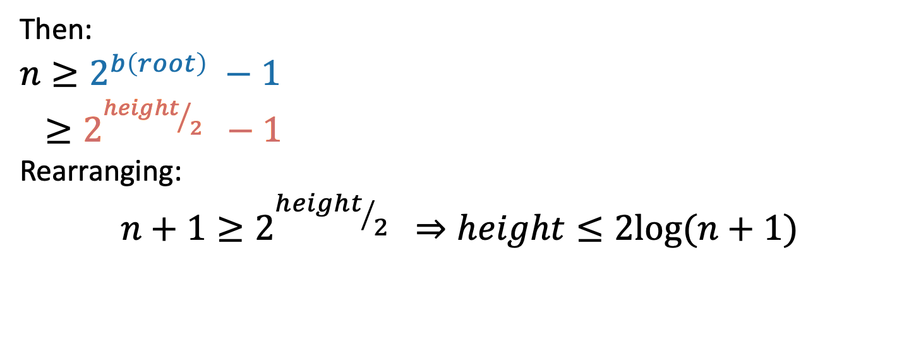
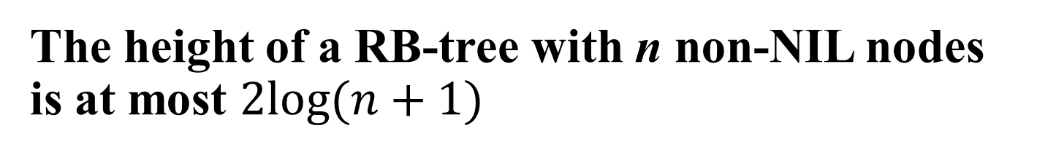
The height of a RB-tree with n non-NIL nodes is at most $2log⁡(n+1)$
x
Define b(x) to be the number of black nodes in any path from x to NIL.
(excluding x, including NIL).
Claim:
There are at least 2^{b(x)} – 1 non-NIL nodes in the subtree underneath x. (Including x).
[Proof by induction – …]
y
z
NIL
Claim: at least 2^{b(x)} – 1 nodes in this WHOLE subtree (of any color).
Then:
$$n≥2^{b\left(root\right)} −1$$
$≥2^{{height}/2 } −1$
Rearranging:
$$n+1≥2^{{height}/2 } ⇒height≤2log⁡(n+1)$$
using the Claim
b(root) >= height/2 because of RBTree rules.

Slide 16
This is great!
SEARCH in an RBTree is immediately O(log(n)), since the depth of an RBTree is O(log(n)).
What about INSERT/DELETE?
Turns out, you can INSERT and DELETE items from an RBTree in time O(log(n)), while maintaining the RBTree property.
That’s why this is a good property!

Slide 17
INSERT: Many cases
6
6
6
3
7
3
7
3
7
Suppose we want to insert 0 here.
There are 3 “important” cases for different colorings of the existing tree, and there are 9 more cases for all of the various symmetries of these 3 cases.

Slide 18
INSERT: Case 1
6
3
7
Make a new red node.
Insert it as you would normally.
What if it looks like this?
Example: insert 0
6
3
7
0

Slide 19
INSERT: Many cases
6
6
6
3
7
3
7
3
7
Suppose we want to insert 0 here.
There are 3 “important” cases for different colorings of the existing tree, and there are 9 more cases for all of the various symmetries of these 3 cases.

Slide 20
INSERT: Case 2
6
3
7
Make a new red node.
Insert it as you would normally.
Fix things up if needed.
What if it looks like this?
Example: insert 0
6
No!
3
7
0

Slide 21
INSERT: Case 2
6
3
7
Make a new red node.
Insert it as you would normally.
Fix things up if needed.
What if it looks like this?
Example: insert 0
Can’t we just insert 0 as a black node?
6
3
7
No!
0

Slide 22
We need a bit more context
6
3
7
What if it looks like this?
-1
Example: insert 0
6
3
7

Slide 23
We need a bit more context
6
3
7
Add 0 as a red node.
What if it looks like this?
-1
Example: insert 0
6
3
7
0

Slide 24
We need a bit more context
6
3
7
Add 0 as a red node.
Claim: RB-Tree properties still hold.
What if it looks like this?
-1
Example: insert 0
6
Flip colors!
3
7
0

Slide 25
But what if that was red?
6
3
7
What if it looks like this?
-1
Example: insert 0
6
3
7
0

Slide 26
More context…
6
3
7
-3
What if it looks like this?
-1
Example: insert 0
6
3
7
0

Slide 27
More context…
6
3
7
-3
What if it looks like this?
-1
Example: insert 0
6
Now we’re basically inserting 6 into some smaller tree. Recurse!
This one!

Slide 28
Example, part I
-3
-1
-4
-2
6
3
7
Want to insert 0 here.

Slide 29
Example, part I
-3
-1
-4
-2
6
3
7
0

Slide 30
Example, part I
-3
-1
-4
-2
6
Flip colors!
3
7
0

Slide 31
Example, part I
-3
Need to know how to insert into trees that look like this…
-1
-4
6
Want to insert 6 here.
-2
3
7
0

Slide 32
INSERT: Many cases
That’s this case!
6
6
6
3
7
3
7
3
7
Suppose we want to insert 0 here.
There are 3 “important” cases for different colorings of the existing tree, and there are 9 more cases for all of the various symmetries of these 3 cases.

Slide 33
INSERT: Case 3
6
3
7
Make a new red node.
Insert it as you would normally.
Fix things up if needed.
What if it looks like this?
6
Example: Insert 0.
Maybe with a subtree below it.
3
7
0

Slide 34
Recall Rotations
Maintain Binary Search Tree (BST) property, while moving stuff around.
X
Y
Y
Y
C
A
B
X
A
X
A
B
C
B
C
That’s not binary!!
CLAIM:
this still has BST property.

Slide 35
Inserting into a Red-Black Tree
6
3
7
Make a new red node.
Insert it as you would normally.
Fix things up if needed.
What if it looks like this?
6
Argue that this is a good thing to do!
3
3
7
0
6
0
7

Slide 36
Example, part 2
-3
-4
-1
Want to insert 6 here.
-2
6
3
7
0

Slide 37
Example, part 2
-3
-1
-4
-1
-3
6
-2
6
3
7
3
7
-4
-2
0
0

Slide 38
Example, part 2
-1
-3
6
7
3
-4
-2
0

Slide 39
Example, part 2
-1
-3
6
7
3
-4
-2
0

Slide 40
Many cases
6
6
6
3
7
3
7
3
7
Suppose we want to insert 0 here.
There are 3 “important” cases for different colorings of the existing tree, and there are 9 more cases for all of the various symmetries of these 3 cases.

Slide 41
INSERT Exercise

Slide 42
Insert
1. Make newly inserted node (z) red.
Every node is colored red or black.
The root node is a black node.
NIL children count as black nodes.
Children of a red node are black nodes.
For all nodes x:
all paths from x to NIL’s have the same number of black nodes on them.
2. If a rule is violated after inserting, do one of the following
Case 1:
z’s “uncle” (y) is red
- Recolor.
- Parent red
- Children black
Case 2:
z’s “uncle” (y) is black
- Rotate & recolor.
- Parent black
- Children red

Slide 43
Insert
Case 1: z’s “uncle” (y) is red, re-color.
Make
- parent red
- Children black
3
Grand Parent
Every node is colored red or black.
The root node is a black node.
NIL children count as black nodes.
Children of a red node are black nodes.
For all nodes x:
all paths from x to NIL’s have the same number of black nodes on them.
1
5
Parent
Uncle
Child
7
3
3
1
5
1
5
7
7

Slide 44
Insert
Case 2: z’s “uncle” (y) is black, rotate.
Make
- parent black
- children red
3
1
5
Every node is colored red or black.
The root node is a black node.
NIL children count as black nodes.
Children of a red node are black nodes.
For all nodes x:
all paths from x to NIL’s have the same number of black nodes on them.
Uncle?
Nil
7
6
3
3
3
1
5
1
6
1
6
7
5
7
5
7
6

Slide 45
Exercise
3
3
1
6
1
6
Insert 8
Recolor
5
7
5
7
Every node is colored red or black.
The root node is a black node.
NIL children count as black nodes.
Children of a red node are black nodes.
For all nodes x:
all paths from x to NIL’s have the same number of black nodes on them.
8
8
Insert 9
3
Rotate
Recolor
1
6
3
3
5
7
1
6
1
6
8
5
8
5
8
9
7
9
7
9

Slide 46
Exercise
Insert 10
Recolor
3
3
1
6
1
6
Every node is colored red or black.
The root node is a black node.
NIL children count as black nodes.
Children of a red node are black nodes.
For all nodes x:
all paths from x to NIL’s have the same number of black nodes on them.
5
8
5
8
7
9
7
9
10
10
Rotate
Recolor
6
6
3
8
3
8
1
5
7
9
1
5
7
9
10
10

Slide 47
Exercise
Insert 10
8
8
5
15
5
15
Every node is colored red or black.
The root node is a black node.
NIL children count as black nodes.
Children of a red node are black nodes.
For all nodes x:
all paths from x to NIL’s have the same number of black nodes on them.
12
19
12
19
9
13
23
9
13
23
10
10
Rotate
Recolor
12
12
8
15
8
15
5
9
13
19
5
9
13
19
23
10
23
10

Slide 48
Deleting from a Red-Black tree
Exercise!

Slide 49
That’s a lot of cases!
You are not responsible for the nitty-gritty details of Red-Black Trees. (For this class)
Though implementing them is a great exercise!
You should know:
What are the properties of an RB tree?
And (more important) why does that guarantee that they are balanced?

Slide 50
What have we learned?
Red-Black Trees always have height at most 2log(n+1).
As with general Binary Search Trees, all operations are O(height)
So all operations with RBTrees are O(log(n)).

Slide 51
Conclusion: The best of both worlds
 | Sorted Arrays | Linked Lists | Binary Search Trees*
Search | O(log(n)) | O(n) | O(log(n))
Delete | O(n) | O(n) | O(log(n))
Insert | O(n) | O(1) | O(log(n))

Slide 52
Today
Begin a brief foray into data structures!
See CS 166 for more!
Binary search trees
You may remember these from CS 106B
They are better when they’re balanced.
this will lead us to…
Self-Balancing Binary Search Trees
Red-Black trees.
Recap

Slide 53
Recap
Balanced binary trees are the best of both worlds!
But we need to keep them balanced.
Red-Black Trees do that for us.
We get O(log(n))-time INSERT/DELETE/SEARCH
Clever idea: have a proxy for balance
5
3
7
2
4
6
8

